Slide 1


Cancer
Zackery Rogers, Luis Rojas, Hector Ladero, Akanksha Kukhraniya, Mariam Ahmad

Slide 2
Analysis
We’re a team who came together to come up with a statistical analysis on Cancer and the data we have collected pinpoints age, race, sex, location, death rates, diagnosis, and survival rates.
We used Python/Pandas, each group member then were task to create Flask API, HTML/CSS, and Javascript.

Slide 3
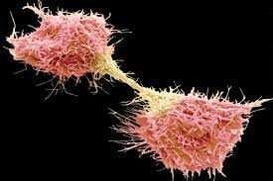
Cancer is a disease in which some of the body’s cells grow uncontrollably and spread to other parts of the body
Cancer can start almost anywhere in the human body, which is made up of trillions of cells.
Normally, human cells grow and multiply (through a process called cell division) to form new cells as the body needs them. When cells grow old or become damaged, they die, and new cells take their place.

Slide 4
Cancer Statistics
1.3 million new diagnoses cases every year
1 in 4 deaths from cancer
Early detection/Improvements in technology have improved prognosis

Slide 5

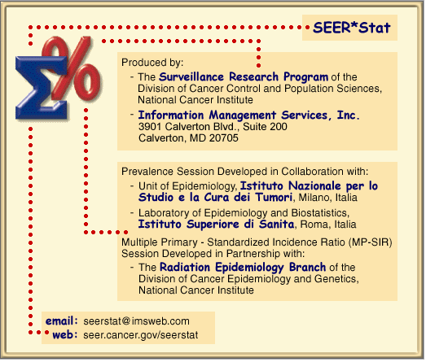



CDC SEER Data

Slide 6



ETL

Slide 7

Heroku

Slide 8
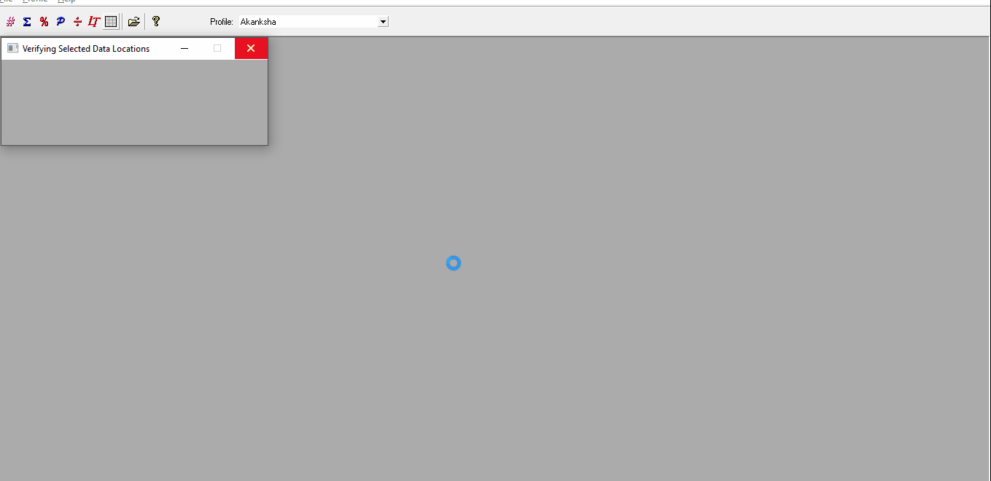
SEER Software

Slide 9
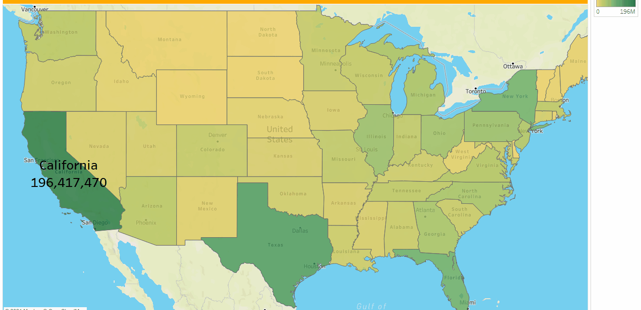

Slide 10
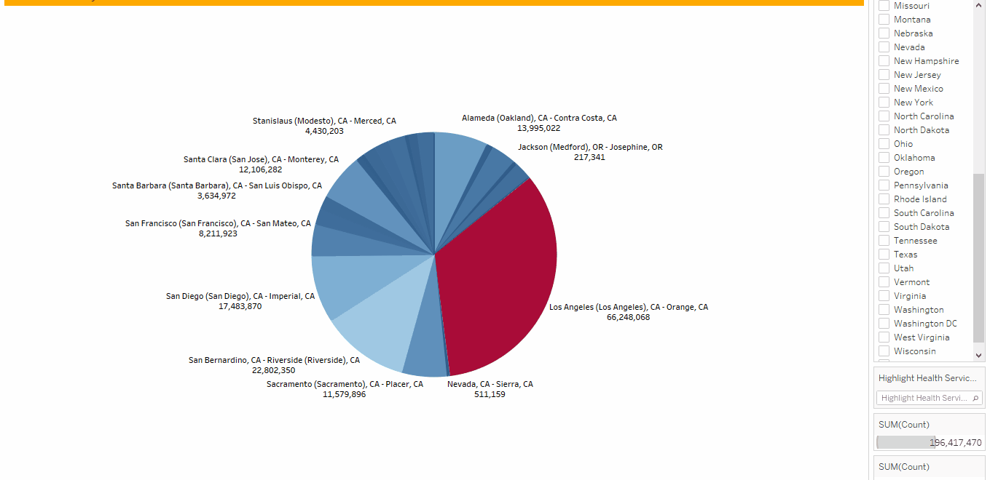

Slide 11
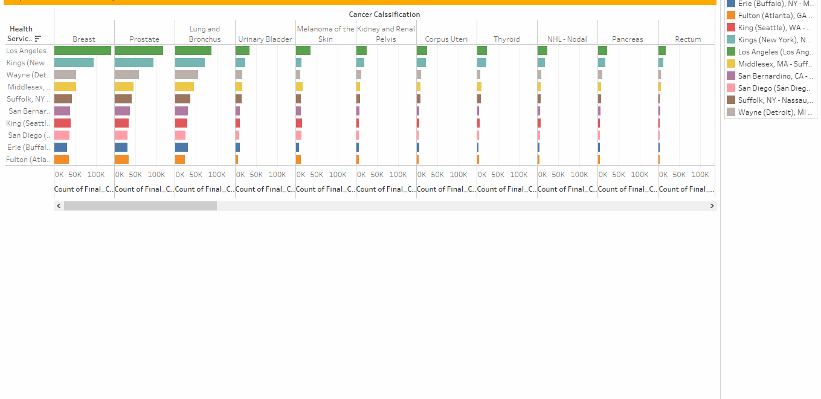

Slide 12
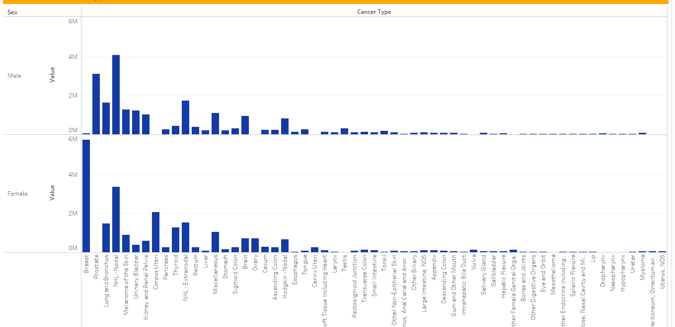
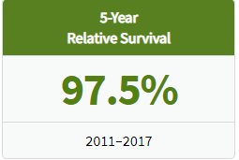
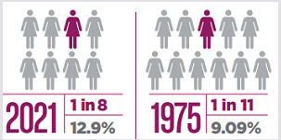
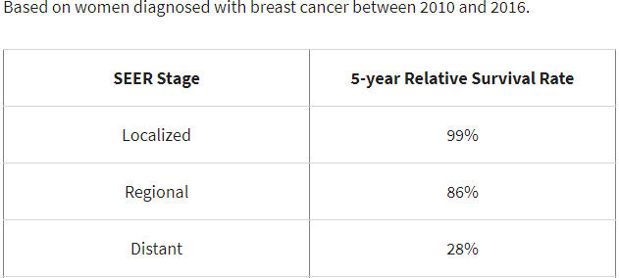

Slide 13
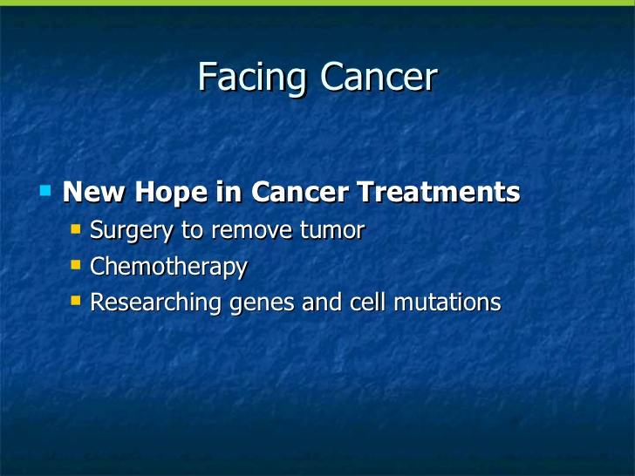

Slide 14

Source File
https://www.kaggle.com/sajidsaifi/prostate-cancer
https://www.cdc.gov/cancer/uscs/public-use/obtain-data.htm
https://www.kaggle.com/uciml/breast-cancer-wisconsin-data

